Slide 1
FAST – NUCES
AI 4092 – FYP II
Physical Layer Security
5G
PLS
in 5G Communication
AI-Driven Jamming Detection & Active Mitigation in Cognitive Radio Networks
Mujtaba Junaid 22K-8709
Rayan Farhan 22K-4102
Ayan Muhammad Zakaria 22K-4728
Supervisor: Dr. Farrukh Shahid Co-Supervisor: Dr. Shahbaz Siddique
FYP Evaluation · April 2026

Slide 2
Presentation Agenda
01
Problem Statement & Motivation
05
ML Pipeline & Models
Why Physical Layer Security matters in 5G CRNs
RF, XGBoost, DNN, 1D-CNN, LSTM on 96 K-file dataset
02
System Architecture
06
Synthetic Data (CTGAN)
Multi-node CRN pipeline, OFDM, QAM, AES-256-GCM
Balanced augmentation via Conditional Tabular GAN
03
Threat Modeling
07
Results & Key Metrics
Jamming agent, Gaussian Barrage & Reactive Bit-Flipping
SINR, spectral heatmaps, power envelopes
04
Spectrum Sensing & Analytics
08
Conclusion & Future Work
Urkowitz energy detection, 183 visualisation plots
Roadmap to real-time deployment

Slide 3
Problem Statement & Motivation
⚡
🔓
🤖
Spectrum Scarcity
Physical Layer Vulnerabilities
No Intelligent Defence
Explosion of 5G-connected devices has exhausted available radio spectrum, necessitating dynamic access via Cognitive Radio Networks (CRNs).
Shared CRN spectrum is exposed to RF jamming attacks — Gaussian Barrage & Reactive Bit-Flipping — that destroy signal integrity and deny service.
Existing simulators abstract signal energy rather than modelling it from raw modulated data, creating fidelity gaps and lacking autonomous AI-driven countermeasures.
Our Solution: A high-fidelity, data-driven 5G CRN simulation framework with autonomous real-time jamming detection and active mitigation via 5 trained ML models.

Slide 4
System Architecture

Slide 5
Threat Modeling & Jamming Infrastructure
Gaussian Barrage Jamming
▸ High-power broadband noise flooding the Base Station
▸ Wideband interference spanning full signal spectrum
▸ Causes signal-to-noise ratio collapse across all subcarriers
▸ Hardest to mitigate without spectral sensing
Detection Response Pipeline:
I/Q Samples → Energy Envelope → ML Classifier → Adaptive Modulation & Coding → Time-Domain Backoff

Slide 6
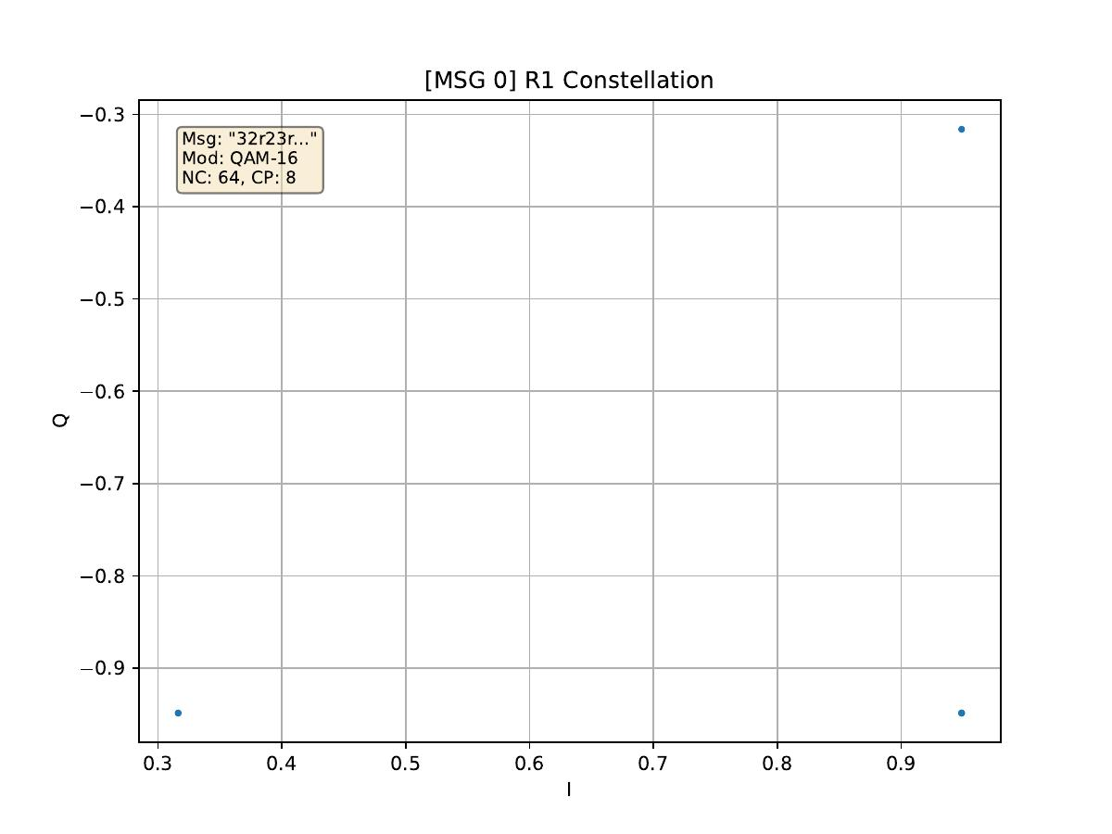
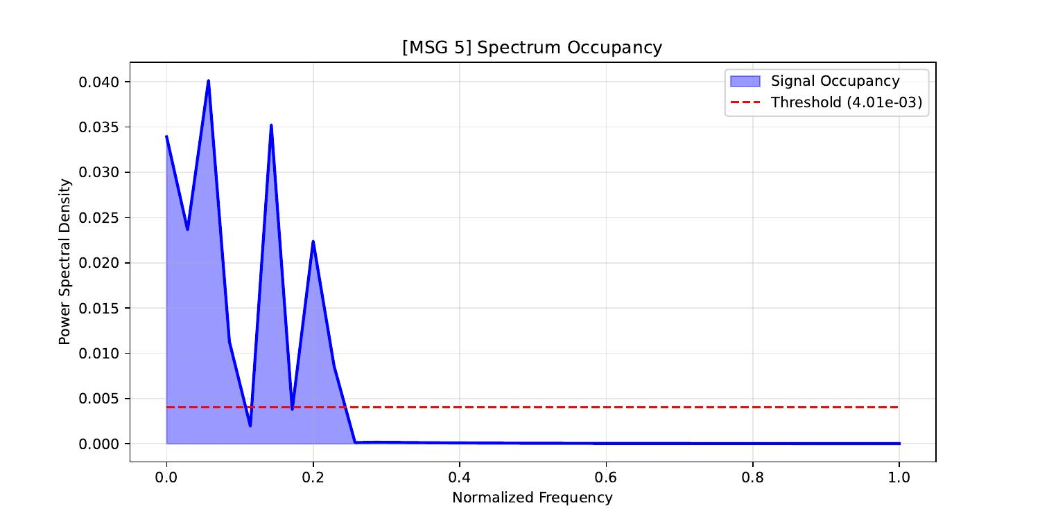
Spectrum Sensing & Visual Analytics
Urkowitz Energy Detection
● Real-time energy envelopes computed directly from OFDM I/Q samples
● Threshold-based spectrum occupancy detection (Urkowitz model)
● Headless Matplotlib engine (Agg backend) for crash-free analytics
QAM-16 Constellation (R1)
● 10 granular plots exported per session — 183 plots in current run
● 3D constellation distortion & SINR degradation visualisations
Spectrum Occupancy – Urkowitz Detection Threshold

Slide 7
Synthetic Data Generation – CTGAN
1
Stratified Loading
2
CTGAN Training
SDV metadata definitions and stratified sampling ensure equal class representation across Gaussian, Pulsed and Clean RF signals.
Conditional Tabular GAN trained on multi-modal RF feature distributions; minority classes synthesised to balance the training corpus.
3
TSTR Validation
4
KDE Evaluation
Train-on-Synthetic, Test-on-Real protocol validates that synthetic samples preserve physical-layer statistical fidelity.
Kernel Density Estimation plots confirm that synthetic feature distributions closely match real captured RF data.
Result: Balanced synthetic RF datasets augment the real 96,090-file corpus, improving minority-class detection accuracy across all 5 ML models.

Slide 8
ML Pipeline & Model Comparison
Dataset: Kaggle RF Jamming Dataset · 96,090 files · 3 classes: Clean / Gaussian / Pulsed Jamming
Random Forest
XGBoost
DNN
1D-CNN
LSTM
Training Size
Training Size
Training Size
Training Size
Training Size
10,000 files (in-memory)
30,000 files (GPU streaming)
96,090 files (full dataset)
96,090 files (buffered gen.)
96,090 files (sequence gen.)
Classical ensemble baseline
Out-of-core gradient boosting
Deep Neural Network
Temporal feature extraction
Long Short-Term Memory
Hybrid Out-of-Core Architecture
Tiered memory strategy prevents Kaggle OOM errors: RF (10K in-memory) → XGBoost (30K GPU-streamed) → DL models (96K buffered generators). Trained models injected directly into Python receiver for real-time inference.

Slide 9
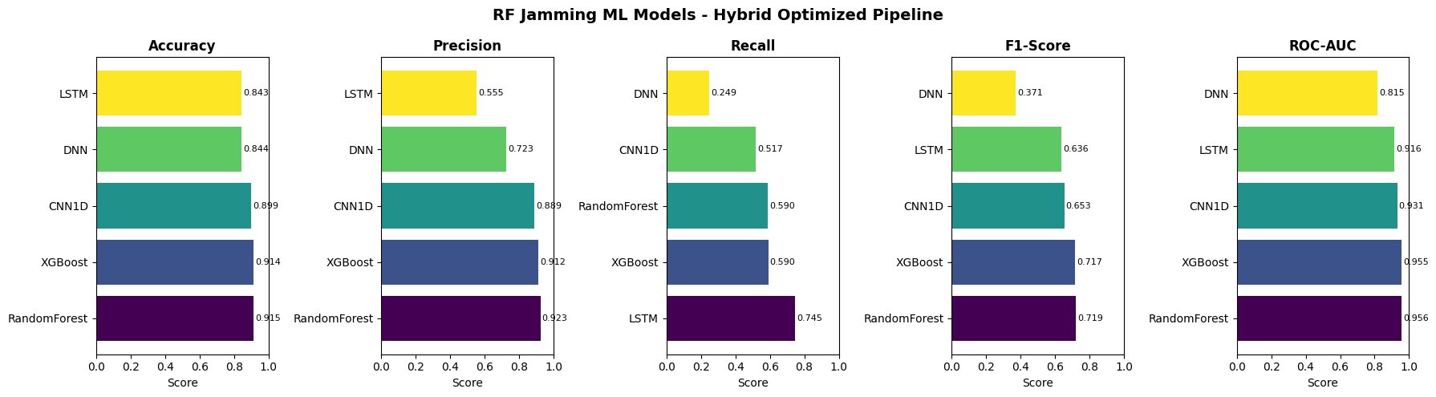
ML Models MetricssComparison
Dataset: Kaggle RF Jamming Dataset · 96,090 files · 3 classes: Clean / Gaussian / Pulsed Jamming

Slide 10
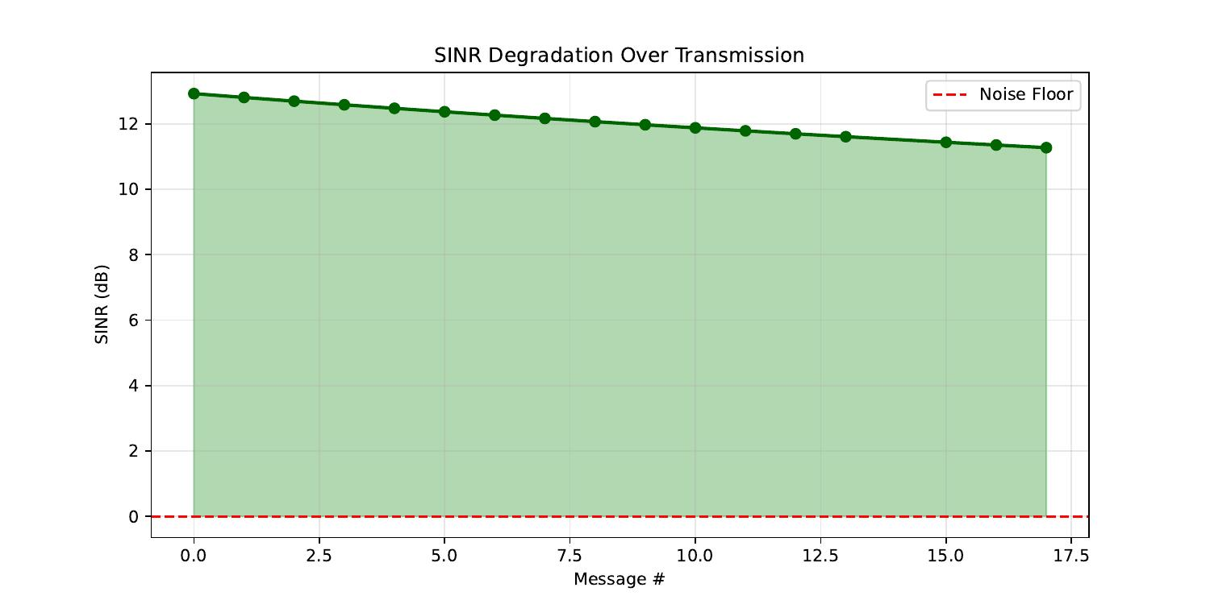
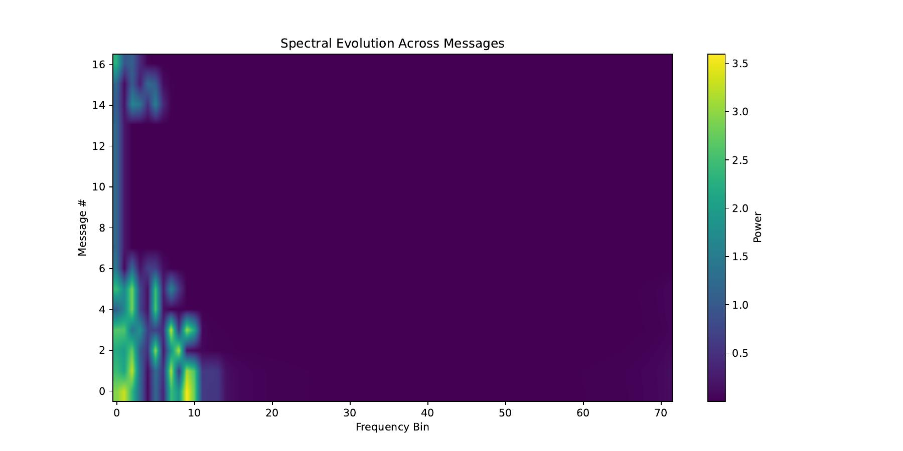
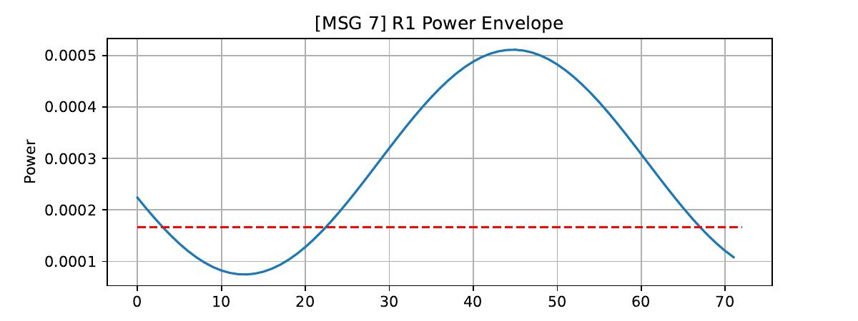
Results & Key Metrics
SINR Degradation Over Transmission (18 messages, QAM-16, 20 dB SNR)
Spectral Evolution Heatmap – Power vs. Frequency Bin across Messages
Key Findings
✓ SNR maintained at 20 dB across all 18 messages
✓ SINR gradually degrades from 13 → 11 dB under sustained interference — stays above noise floor
✓ Spectral energy confined to low-frequency bins confirming clean spectrum allocation
✓ Power envelope threshold breach triggers ML-based jammer alert
Power Envelope – Urkowitz detection threshold (red dashed)

Slide 11
Development Timeline
Sep '25
1.1 – Initial OFDM Pipeline
Oct '25
1.2 – Sender/Receiver + Base Station
Nov '25
1.3–1.6 – Agents, Plots, Spectrum Sensing
Jan '26
2.1 – Network Scaling & Pre-emption
Feb '26
2.2–2.3 – Jamming Agent & Analytics
Mar '26
2.4–2.5 – CTGAN + 5 ML Models

Slide 12
Conclusion & Future Work
What We Achieved
✔ High-fidelity multi-node 5G CRN simulation with thread-safe architecture
✔ Two realistic jamming attack vectors modelled and injected
✔ Urkowitz energy detection with 183 analytical visualisation plots
✔ Hybrid ML pipeline across 5 models trained on 96,090-file RF dataset
✔ CTGAN synthetic augmentation with TSTR + KDE validation
✔ End-to-end real-time AI detection loop integrated into receiver
📂 Kaggle Notebook: kaggle.com/code/mujtabajunaid/fyp-final

Slide 13
Thank
You
Physical Layer Security in 5G Communication · FAST-NUCES Karachi · April 2026

